Slide 1
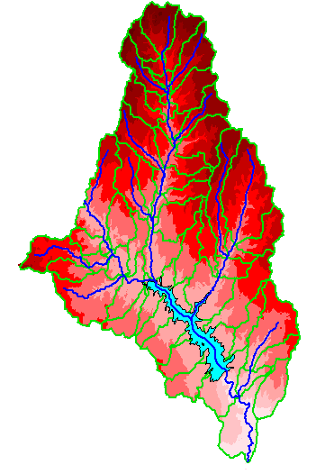
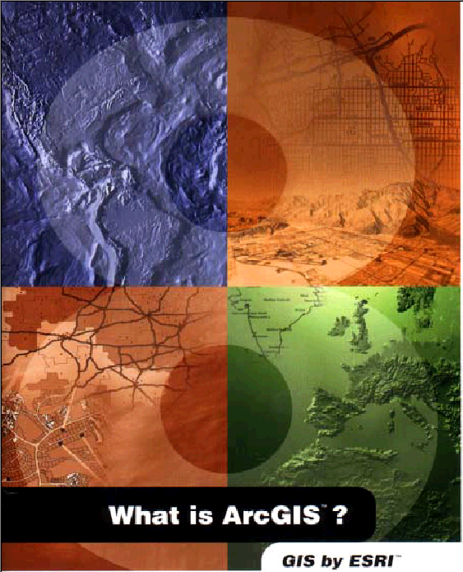
ArcGIS
Presented by:
Karan Millan Thevar (https://www.linkedin.com/in/karanmthevar/)
Pratik Patre (https://www.linkedin.com/in/pratikpatre/)
Rahul Chandra (https://www.linkedin.com/in/chandra-rahul/)
Under the Supervision of:
Prof Srikanth Krishnamurthy

Slide 2
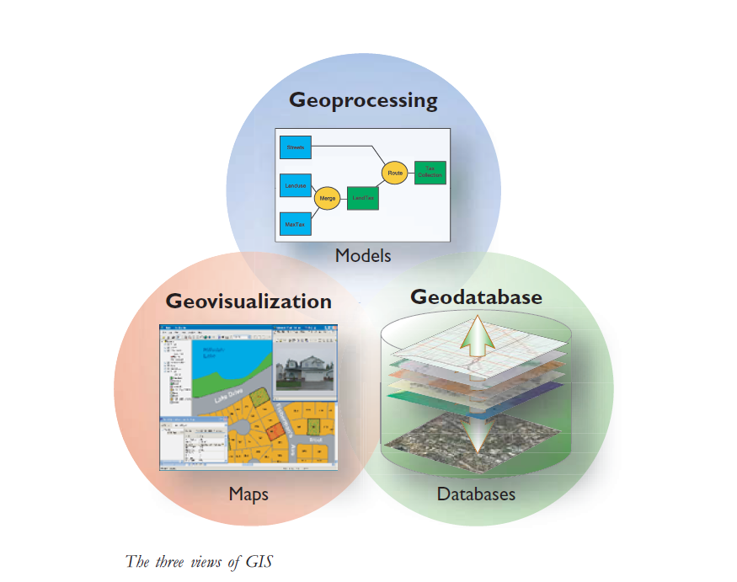
What is GIS?
A geographic information system (or GIS) is a system designed to capture, store, manipulate, analyze, manage, and present spatial or geographic data.
GIS includes a set of comprehensive tools to work with the geographic data.

Slide 3

Introduction to ArcGIS
What is ArcGIS?
It is a product of Environmental System Research Institute(ESRI)
It is an integrated collection of GIS software products for building a complete GIS.
The ArcGIS framework enables you to deploy GIS functionality in desktops, servers, or mobile devices.
ArcGIS provides tools for mapping and spatial reasoning so you can explore data and share location-based insights.

Slide 4
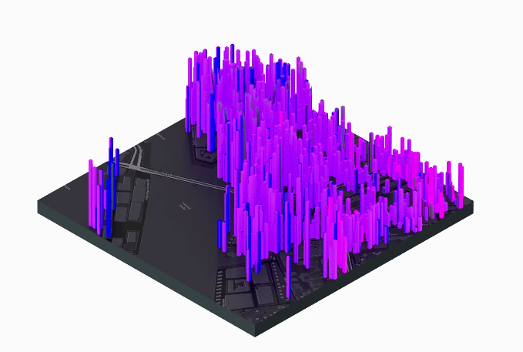
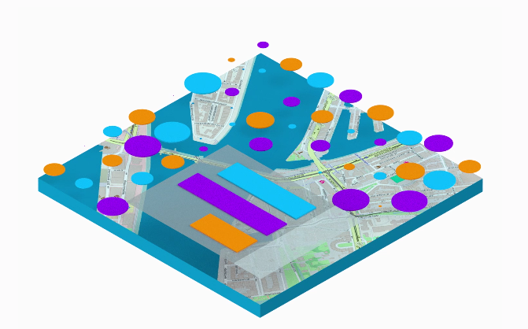
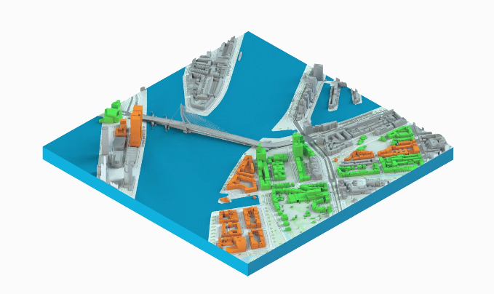
Applications of ArcGIS
Spatial Analytics
Use : Police
Mapping and Visualization
Use : Business Prospects
3D GIS
Use : Geo Scientist

Slide 5
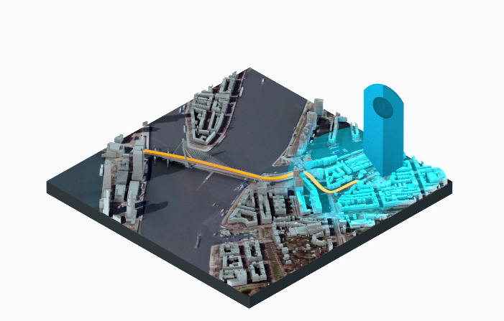
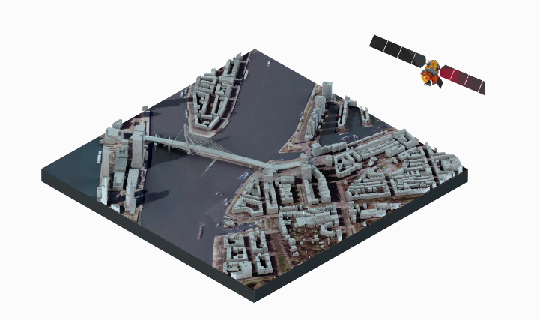
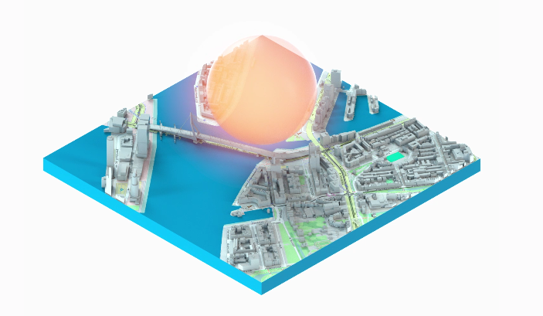
Real Time GIS
Use : Government Agencies
Imagery and Remote Sensing
Use : Military
Data Collection and Management
Use : Sharing data efficiently

Slide 6
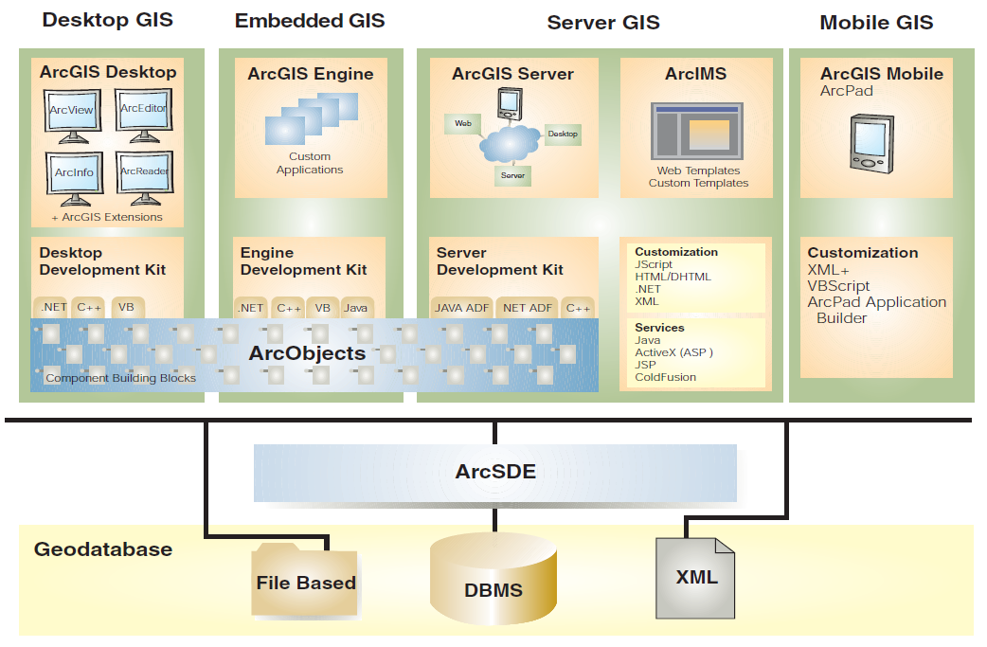
ArcGIS Frameworks
ArcGIS Desktop: an integrated suite of professional GIS applications.
ArcGIS Engine: embeddable developer components for custom GIS applications.
Server GIS: ArcSDE, ArcIMS, and ArcGIS server.
Mobile GIS: ArcPad as well as ArcGIS Desktop and Engine for Tablet PC computing.

Slide 7
ArcGIS Demo
CASE STUDY:
Crime Statistics using ArcGIS and R

Slide 8
CASE STUDY:
Analyze Crime Using Statistics and the R-ArcGIS Bridge
R-ArcGIS Bridge

Slide 9





Alternative to ArcGIS

Slide 10
References:
Wikipedia links on ArcGIS
http://www.cosb.us/county-departments/geographic-information-systems-gis/#.WNY8HzsrI2x
http://www.qgis.org/en/site/
http://gisgeography.com/qgis-arcgis-differences/
downloads.esri.com/support/documentation/ao_/698what_is_arcgis.pdf
Git link :
https://github.com/rahchandra/DataScience/tree/master/ClassPresentation

Slide 11
Thank You

